Slide 1
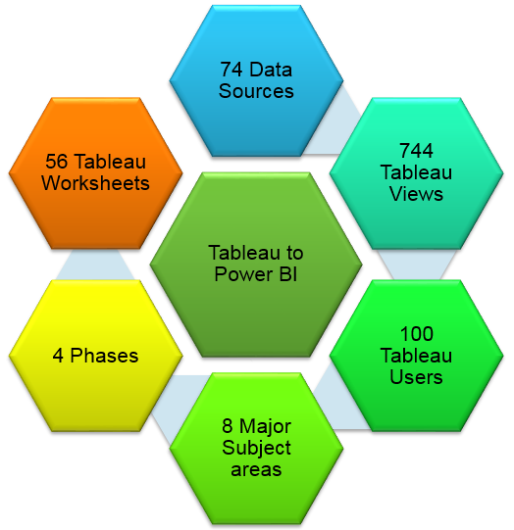
OVERVIEW
Project : Predict Advertising Sales (Multivariant)
Executive Summary
Background:
Analyze sales for ABC , a large retail giant of consumer products. Measure the impact of advertising through our channels on their sales. Know which medium drove sales the most thus helping ABC focus their advertising budgets on promotions that bring the greatest return on investment. Also help ABC reduce waste on Ad Sales.
Project Duration - July 13th to July 25th
Objectives:
Use Machine Language , Feed training data ( Sales history for the past three years ) , fit model and predict sales for a particular number of advertisements within each medium.
In Scope: Features: TV, Radio, Newspaper Ad Count; Label: Sales
Out of Scope:
TV
ad count
Use ML to find the relationship between ad count & sales, and to predict the sales for a particular number of advertisement within each business unit.
Digital Impressions count
SL/HL Language
Brand information
Digital Impressions
Radio ad count
Sales
SL/HL Language
Project Known Risks:
Newspaper ad count
Brand
More features , more complexity
Limited time
Technology and Tools used
Project :
Kaggle Dataset:https://www.kaggle.com/purbar/advertising-data
by
Ad Count v/s Sales relationship and Predict Advertising Dollars
Scikit-Learn
Pandas
numpy
Pairplot using seaborn library
Pandas correaltion
Finance
Sajani Menon
1

Slide 2
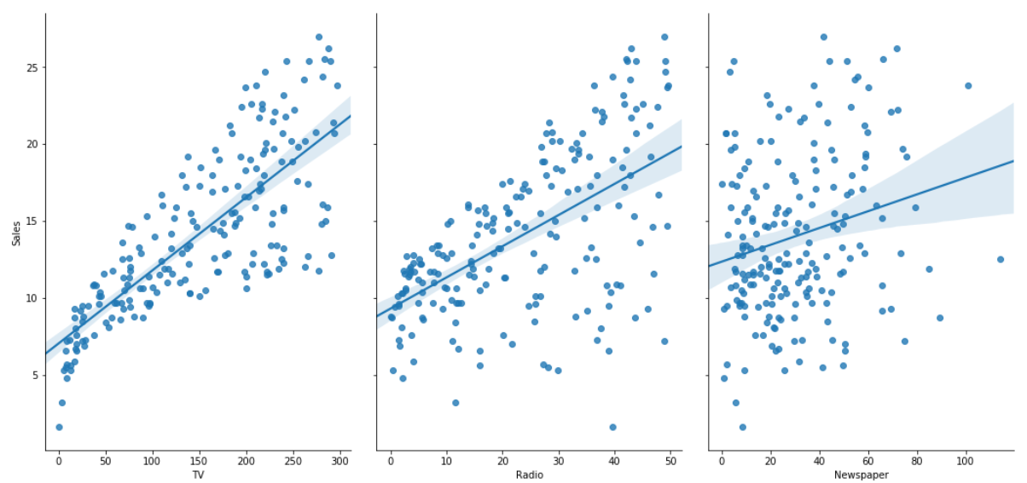
Workflow
Workflow
Step 1 : Find relationship of each feature with label respectively by making a pairplot using seaborn library .
Step 2: Use pandas correlation function to find the correlation between each feature all together.
TV more linear than Radio and newspaper
Traditional ML Steps
Predict Sales using linear regression
(Split data into train and test)
Calculate the root_mean_squared_error and the r-squared value for the testing data
Call the `score` method on the model to show the r2
Run linear regression 1000 times to calculate root mean square error &
use cross validation to check best features
2 features
TV and Radio
3 features
TV & Radio & Newspaper
Accuracy with 2 features
Tv and Radio
– 1.679
✓
Root mean square error
= 1.7015225171783763
Root mean square error
= 1.7064672823236582
✓
Accuracy with 3 features
Tv and Radio and newspaper
– 1.691
mean_squared_error
= 2.904438618371681
mean_squared_error
= 2.9970670746628683
Additional Steps

Slide 3
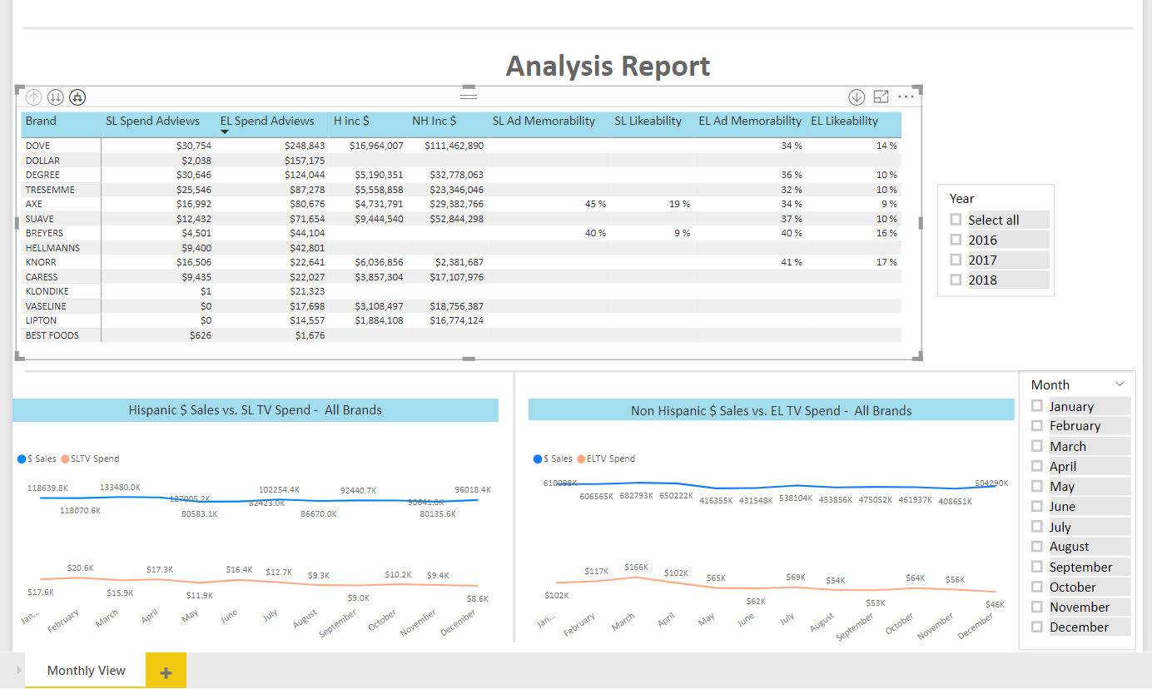
Data Analysis and Visualization
Visualization
✓
✓

